Slide 1


CS 513-B Final Project
By: Matthew Angelakos(20005936) Tri Luu(20007629)
Section: B
Group: 22
Project Name: Super Smash Brothers Melee Win Loss Classification

Slide 2
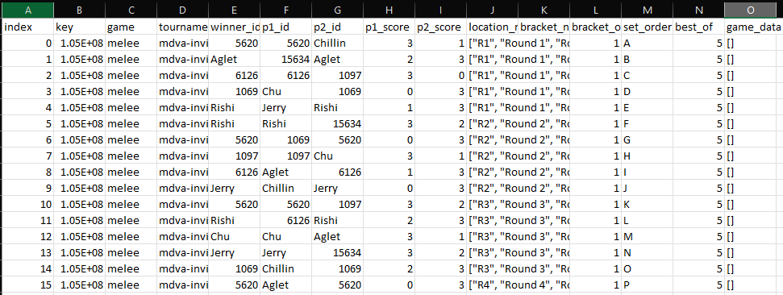
What is our project?
We got our dataset at https://www.kaggle.com/datasets/thomasdubail/super-smash-bros-database/
This dataset is a collection of sets for the eSport Super Smash Brothers Melee from the years of 2018 to 2023. This game is a 1v1 fighting game where you choose from 25 characters and pick from 6 stages and attempt to beat your opponent.
This is the original form of the dataset containing over 1156635 data points!

Slide 3
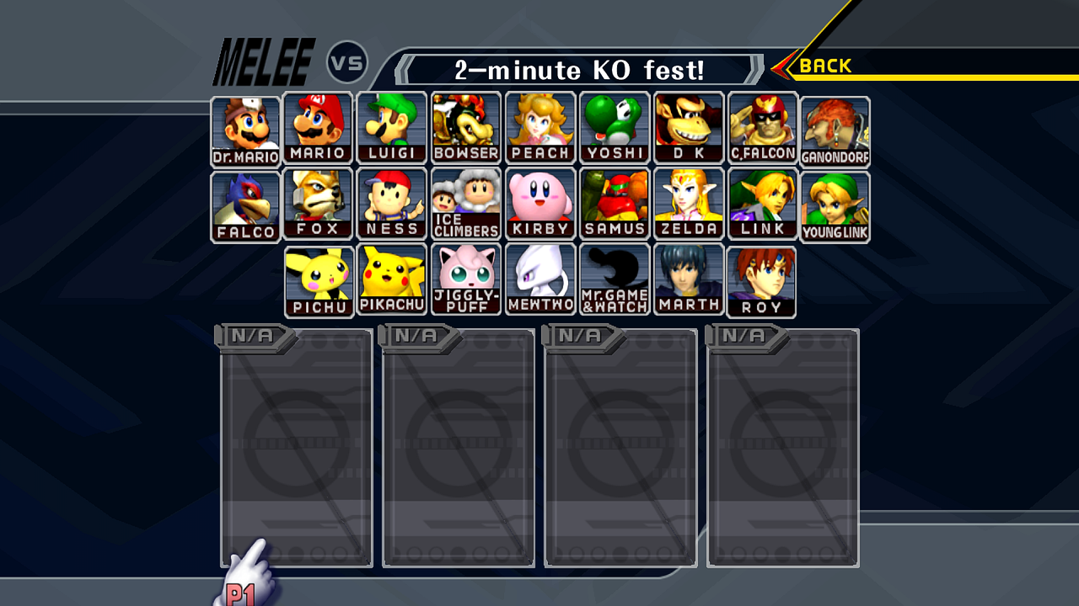
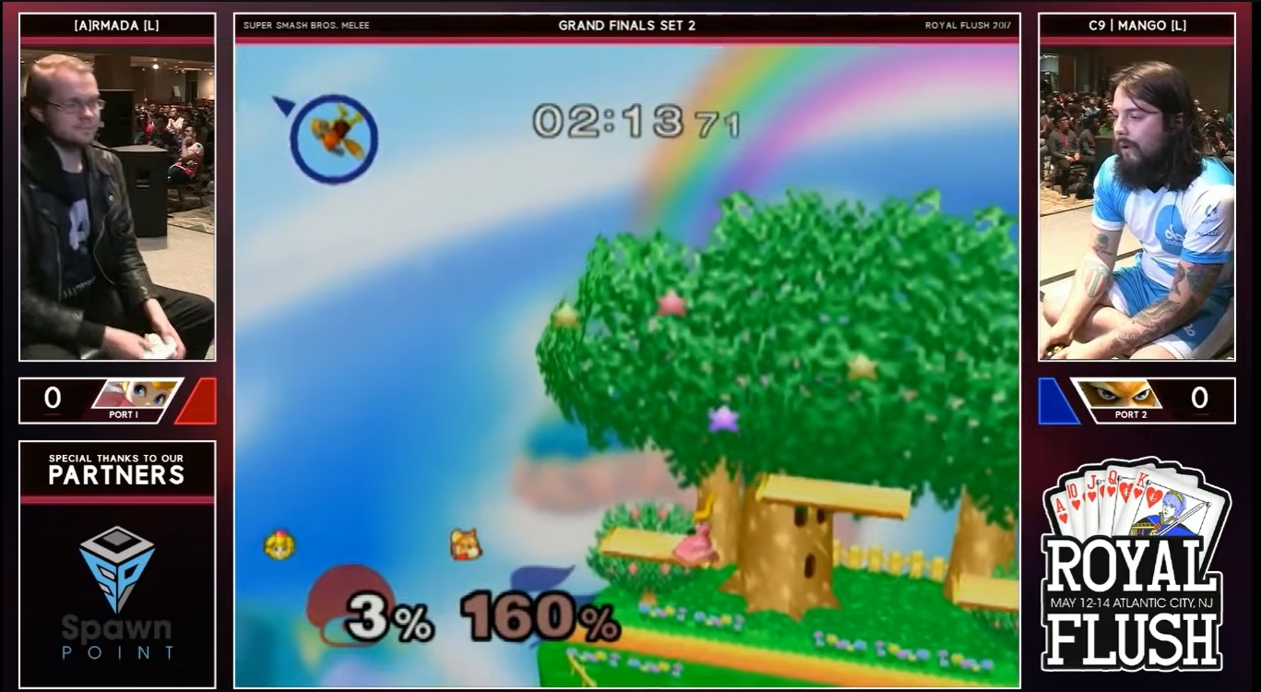
What do we wish to accomplish?
The overall goal of over project is to develop a binary classification model to predict whether player(p1 or player 1) won or lost against their opponent in a given match
To accomplish this we wish to feed our model all possible pre-game attributes with all values of our dataset in order to develop this model
To do this however we must first clean our data to be in a useable form to run models on

Slide 4
Expansion of the game_data column
[{"winner_id": 288832, "loser_id": 1409499, "winner_score": null, "loser_score": null, "winner_char": "melee/fox", "loser_char": "melee/captainfalcon", "stage": "Yoshi's Story"}, {"winner_id": 288832, "loser_id": 1409499, "winner_score": null, "loser_score": null, "winner_char": "melee/fox", "loser_char": "melee/captainfalcon", "stage": "Battlefield"}]
Each of the {} indicates a different match and the attributes in each match that we can extract as attributes

Slide 5
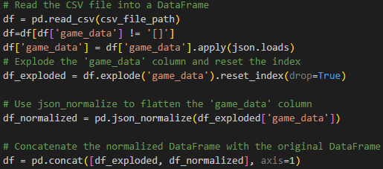
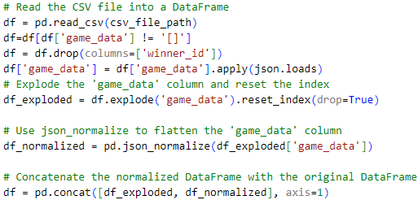
Data Cleaning Part 1
We first need to expand the ‘game_data’ column so that we can get all the attributes of each individual match.
We will decide to remove all rows where there is no game data as the data there is categorical there is no way to get an average or something of the sort in regards to characters or stages.
Also there would be no way to tell who won any of the matches

Slide 6
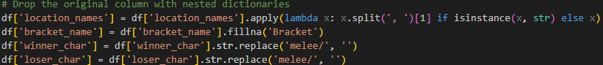
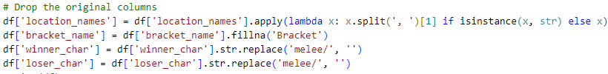
Data Cleaning Part 2
We then need to remove certain attributes that are not potential predictors for the outcome of the match
These include:
‘index’: This is not an actual attribute but it's just the index of where it is the database which is not actually part of the matches at all
‘game’: We are only examining Melee so this is irrelevant
‘game_data’: We are gonna expand the data in here eventually so this will be need to be removed
‘key’: Same reason as index
‘winner_score’, ‘loser_score’: These are post game attributes so they cannot be a factor in predicting the outcome
‘winner_id’: This is the winner of the whole set and not an individual match so it is not applicable here
Next we standardize the naming conventions for the characters, the location name, and also decide to add a standard ‘bracket_name’ to just be the default ‘Bracket’ and we do not have to throw away all data without it

Slide 7
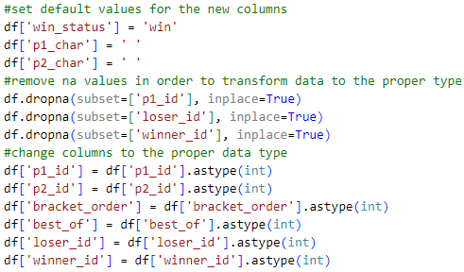
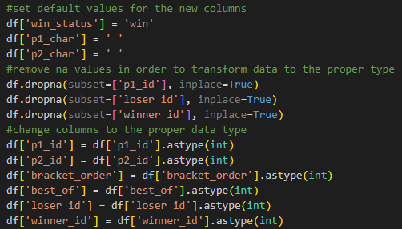
Data Cleaning Part 3
We must now alter the dataframe in order to indicate if player 1 won the match
We do this by locating where the player 1 id is equal to the winner id, if so in the new column ‘win_status’ will be equal to ‘win’ and if not then it is ‘lose’

Slide 8
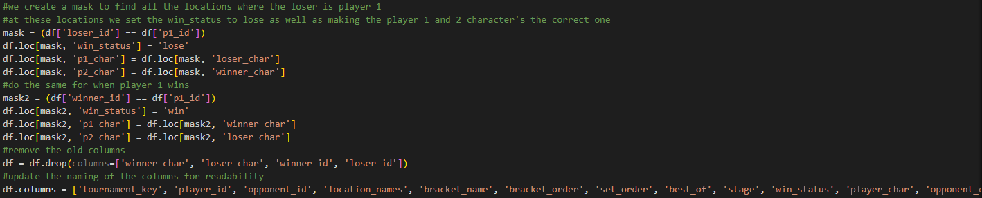
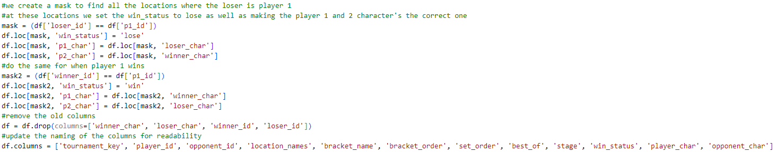
Data Cleaning Part 4

Slide 9
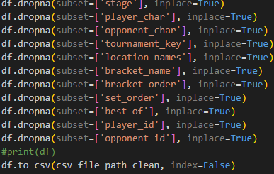
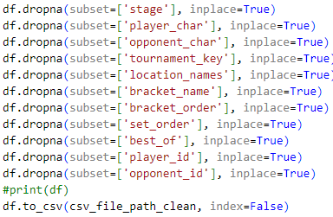
Data Cleaning Part 5
If any NAN values exist now we now wish to remove them
At this point the 1st cleaned dataset can be saved

Slide 10
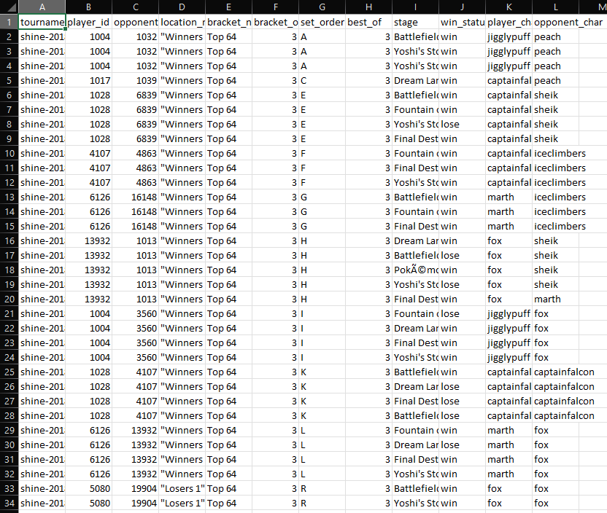
1st Cleaned Data Set

Slide 11
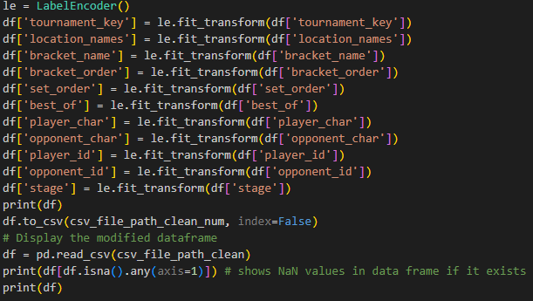
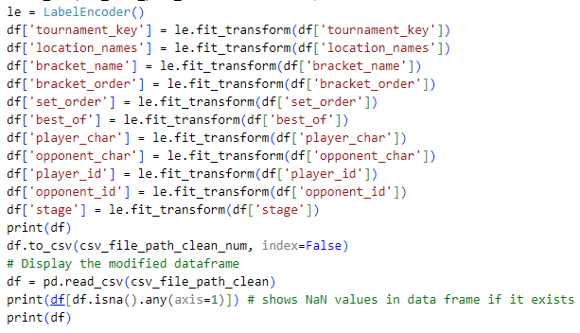
Data Cleaning Part 6
If we wish to use certain models it will need to be a numerical dataset so we convert the dataframe to be numerical and also save it into a different dataset

Slide 12
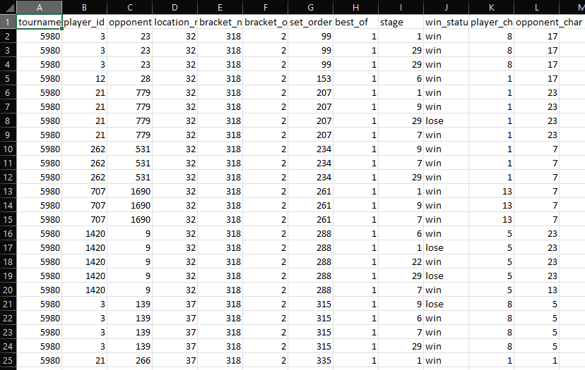
2nd Cleaned Data Set
Each number in this new dataset represents a unique value in the other dataset based on a label encoder.
1083300 rows in total!

Slide 13
Attributes Explained
Attribute Values(11 attributes)
tournament_key: What tournament the match occurred at
player_id: Who the player is
opponent_id: Who the opponent is
location_names: What round of the tournament it occurred in
bracket_name: Where part of bracket it occurred in
bracket_order: When did the bracket happen in relation to other brackets
set_order: When the match happened relative to other ones in the same part of bracket
best_of: How many rounds in order to win the match
stage: Which in game stage the match was played on
player_character: Who the player played
opponent_character: Who the opponent played
Target Values(1 target)
win_status: Did the player win or lose the match
Training and testing sets:
20% for testing and 80% for training

Slide 14
Data Scaling
Standard Scaler
In order to use certain models such as the logistic regression model and ANN we use the standard scaler in order to normalize the data

Slide 15
Classification Models
Notes:
xgboost
why I didn’t use naive bayes

Slide 16
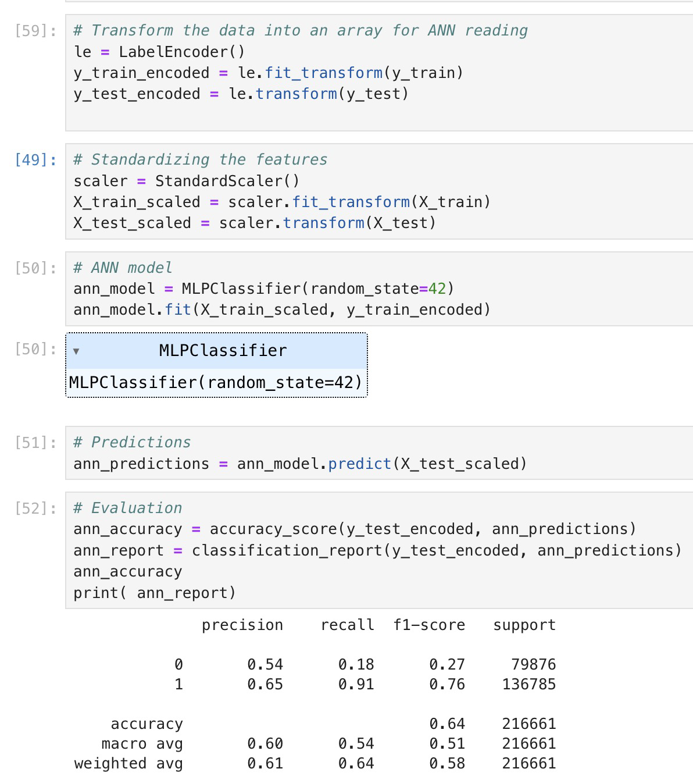
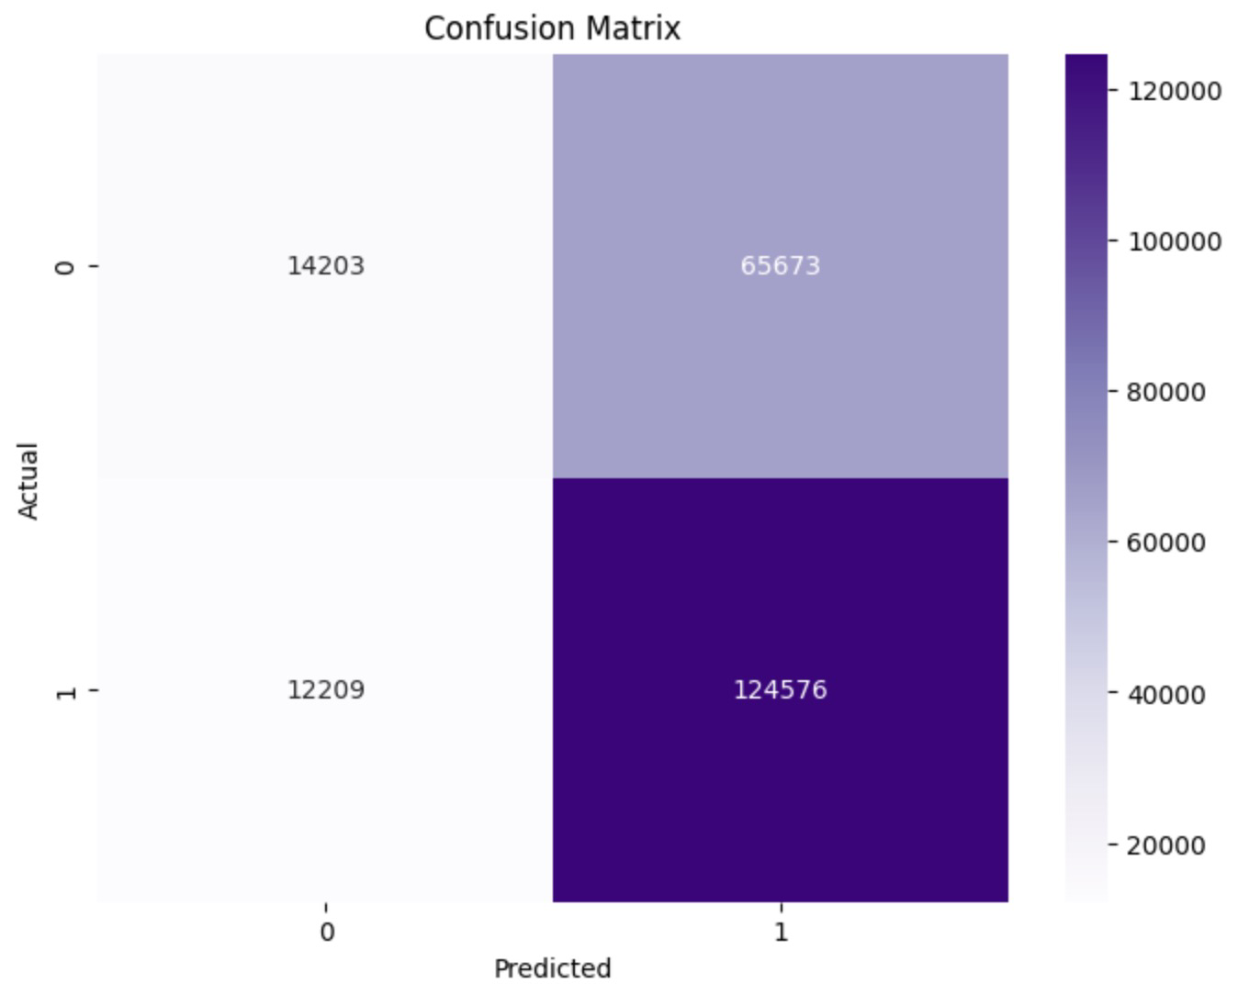
ANN
Since we are predicting based on non-linear features, ANN is considered a good option for an extensive resource model

Slide 17
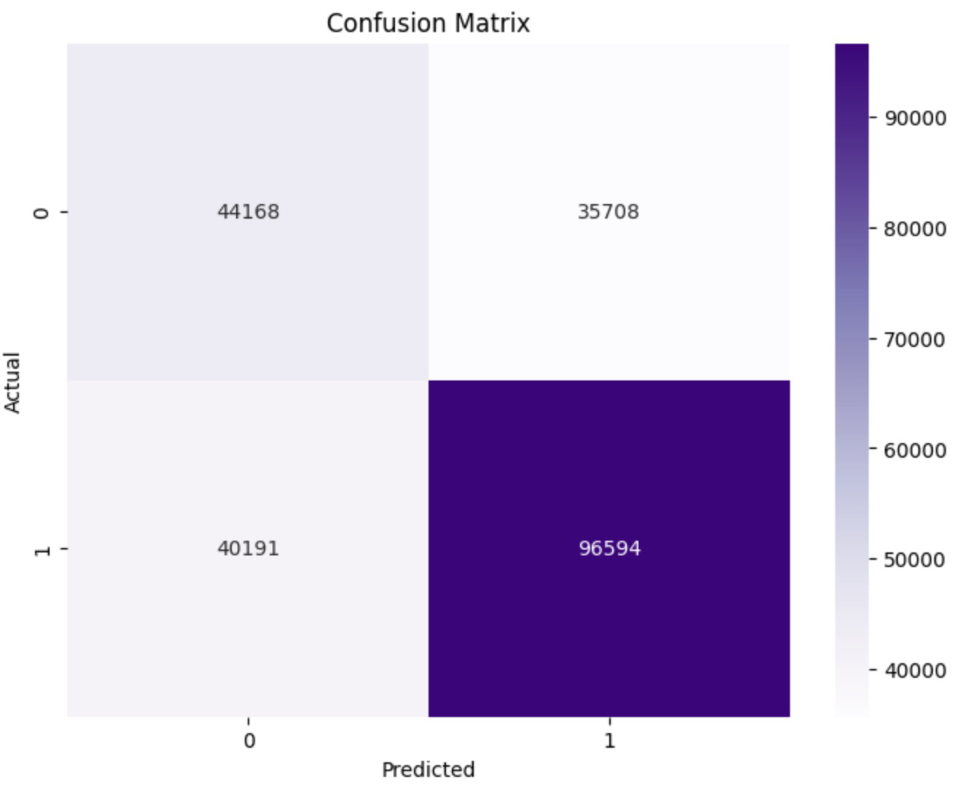
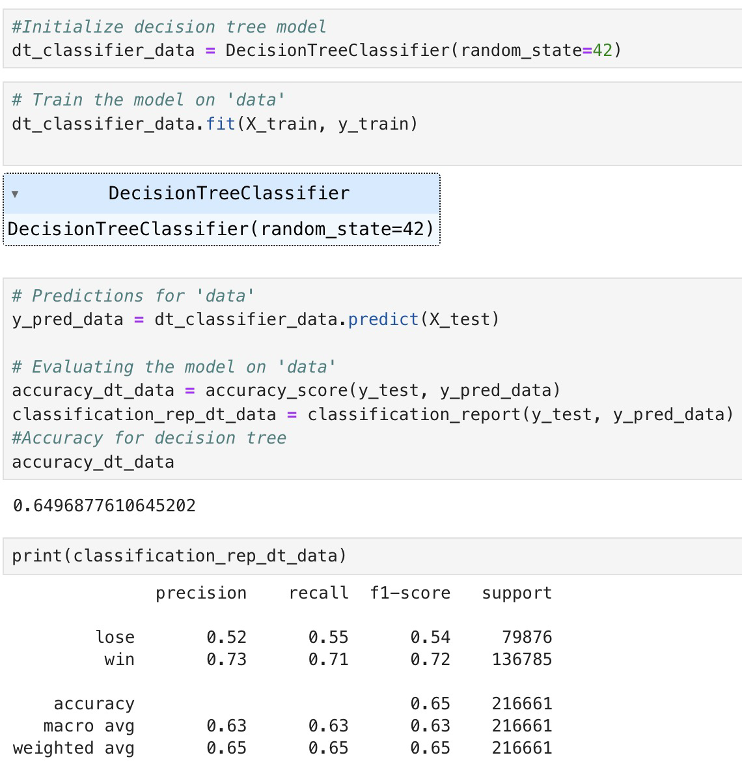
Decision Trees
Notes:
-Easy to interpret
-Practical, easy for business people

Slide 18
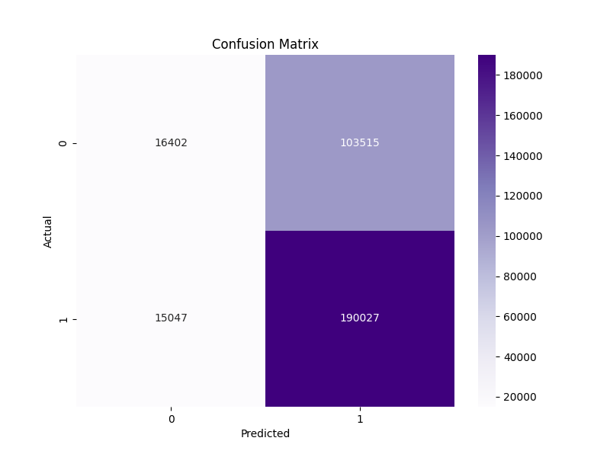
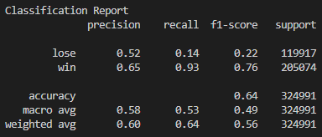
Logistic Regression Model
Uses Standard Scaler normalization
Very poor result for loss data as based on the results of logistic regression it overpredicts when it wins

Slide 19

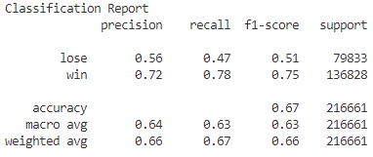
ADAboost
max depth: 11
max nodes: 110
accuracy: 67%

Slide 20
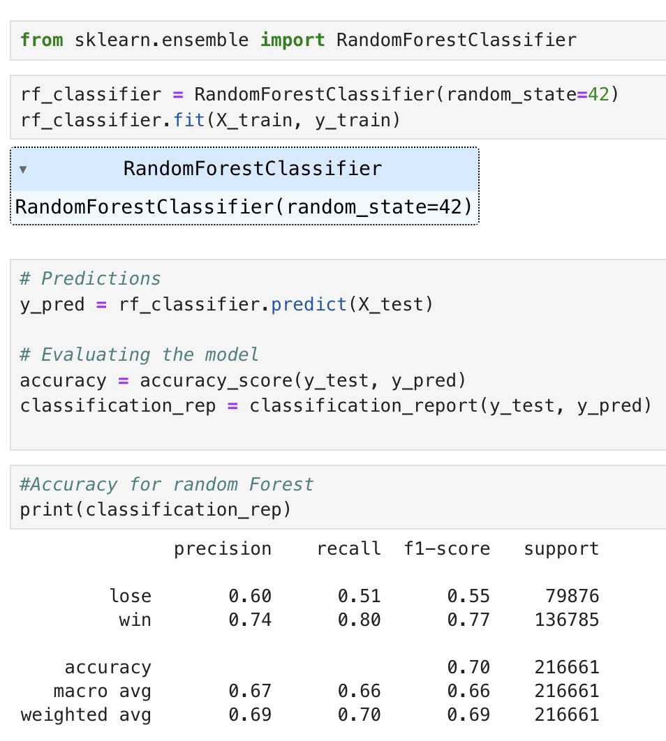
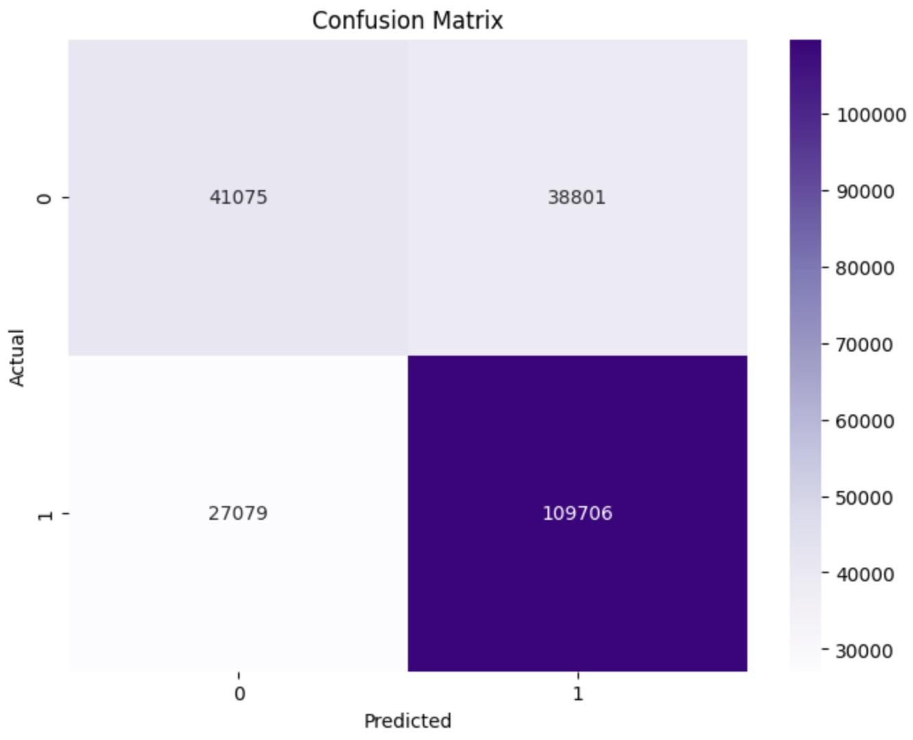
Random Forest
Notes:
-Ability to efficiently processes the dataset's combination of categorical and numerical data.
-Multiple trees reduce the risk of overfitting, improving generalizability.
- Provides insights into which factors most influence match outcomes, valuable for strategic analysis.
- Stand out to have high accuracy and can handle the dataset's potential non-linear relationships.

Slide 21
Conclusion

Slide 22
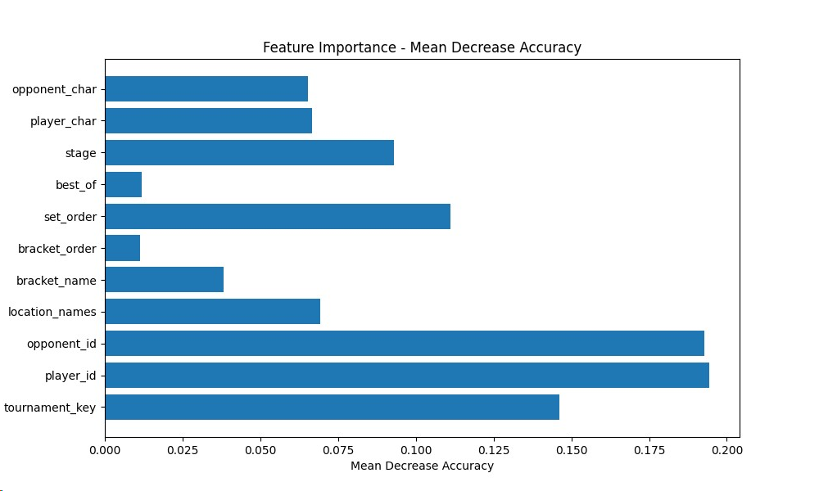
Attribute Analysis for ADAboost

Slide 23
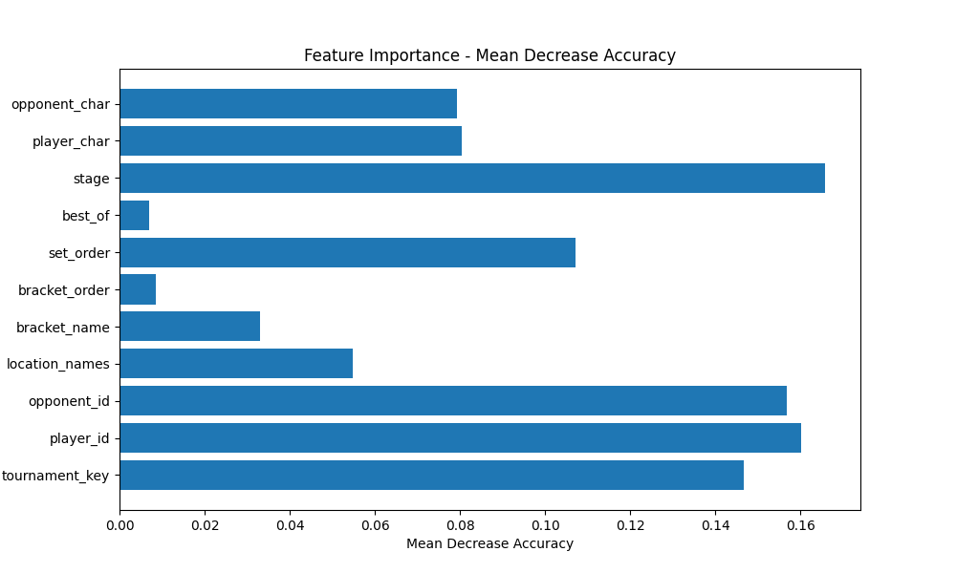
Attribute Analysis for Random Forest

Slide 24
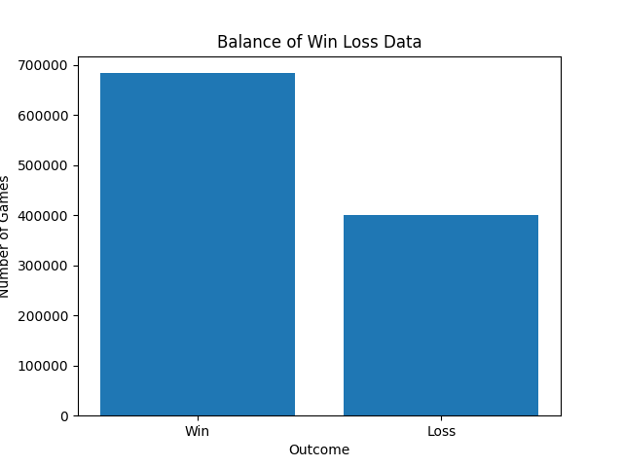
Win Loss Analysis
The person who is player 1 seems to win a majority of the time
Leads to around a 65-35 split in the data which may explain low f1 scores for loss

Slide 25
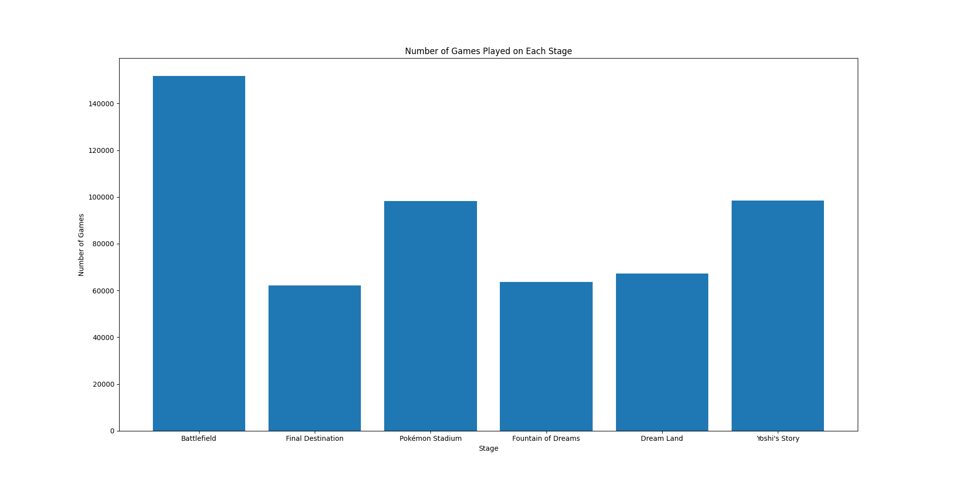
Stage Analysis
Note we just do
games played
and not win rate
as both players
play on the same
stage

Slide 26
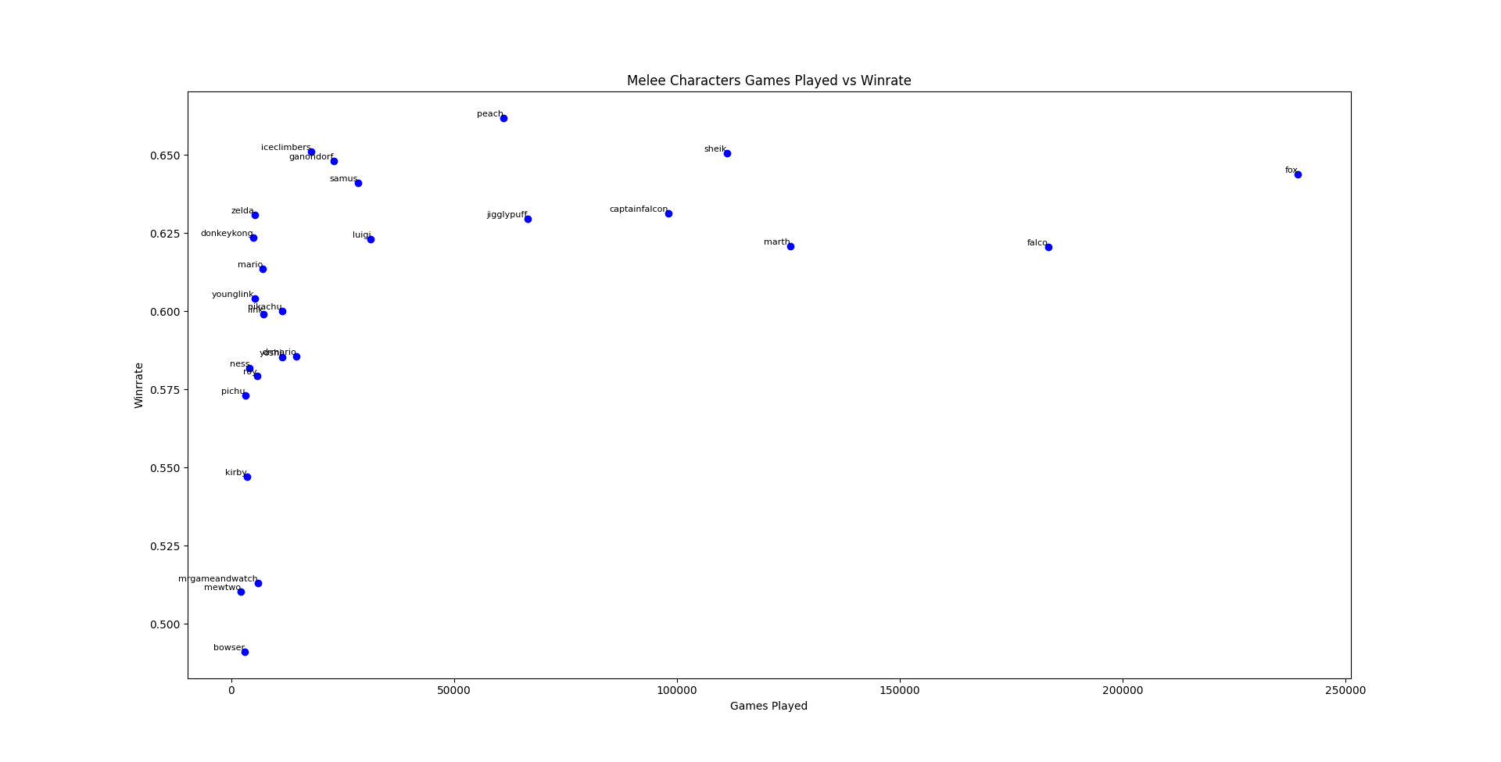
Character Analysis (1)

Slide 27
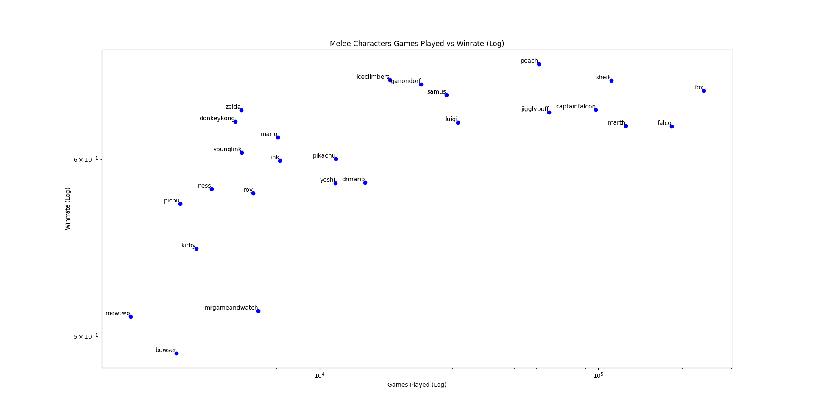
Character Analysis (2)

Slide 28
Potential Applications
Game Developer Decisions:
As seen from the analysis the character that you play and the character that your opponent plays has a high impact on the outcome of the game. As shown many of these characters are stronger and have stronger play rates than others. Game Developers can use this data for a potential sequel or remaster in order to balance the roster more.
Stage also plays a significant role in the outcome of a game. Game Developers can similarly act on this data in order to either make the stages more balanced and potentially redesign the stages in order for more people to want to play on them.
eSport Teams:
Some of the strongest predictors on if player 1 wins is who they are, who their opponent is, and what tournament it happened at. All of which suggests player skill is the most important factor in determining a winner.
From which eSport Teams can make more informed decisions on who to sponsor safely based on simply who are the strongest players with the best win rates over everyone else.
Tournament Organizers(TOs):
Similarly to eSport Teams, TOs can use this data to better accurately predict the winners and therefore seed the brackets more fairly for all entrants based on win rates of each player
As shown in the attribute analysis the amount of games in a set does not seem to impact the outcome much. Because tournaments take a long time to run TOs can safely change most sets to be best of 3 in order to decrease the length of the tournament
Similarly to the Game Developer perspective, TOs can potentially opt to ban certain characters or stages if they deem them to be too strong and unfair to match integrity
Notes:
-Game developers can buff or nerf ( remaster/ balance)
-Stage balance/redesign stages in order for more people to want to play on them
eSport Teams:
who the player, opponent, tournament => player skill is the most important factor
Better predicting of win rates => Better decisions on who to sponsor safely
TOs:
Seed the bracket fairly
Best of doesn’t matter that much => reduce

